Slide 1
IMAGENARY
A Journey into Dynamic Image
Enhancement
By :
Dhyan Rai
ShanuPrakash
Pranam Hebbar
Hulan Changappa

Slide 2
About the project
Imagenary is an AI-powered image enhancement platform designed to revolutionize digital image editing. With features like Image Restoration and Generative Fill, Imagenary empowers users to bring their images to life with precision and ease.
Built with JavaScript (React), CSS (Tailwind), and HTML5, Imagenary offers a seamless user experience and integrates with the Cloudinary API for powerful image transformations.

Slide 3
Objectives
Enhancements
Interface
Affordability
Offer intelligent generative fill and restoration capabilities
an intuitive and easy-to-use platform
ensuring that anyone can benefit from the platform without financial barriers.

Slide 4
Problem Statement
In the digital age, Traditional methods for image enhancement and restoration often require expensive software or specialized skills, making it difficult for average users to achieve professional results. Additionally, creative tasks such as generating new content or filling in missing parts of an image are typically limited to high-cost platforms like DALL-E and MidJourney.
The challenge is to develop an accessible, user-friendly platform that leverages advanced AI technologies to provide high-quality image enhancement and generative fill capabilities without the associated costs, making it available to a wider audience.

Slide 5
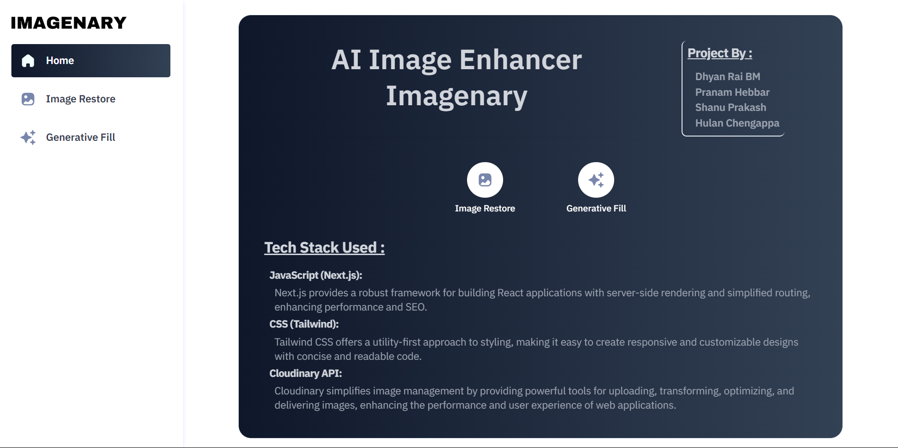
Designing Using TailWind CSS
Tailwind CSS is a modular and highly customizable library because of its:
Utility-First Approach
Easy Responsive Design
Simplicity
We are using a TailwindCSS variant called “ShadCN UI”

Slide 6
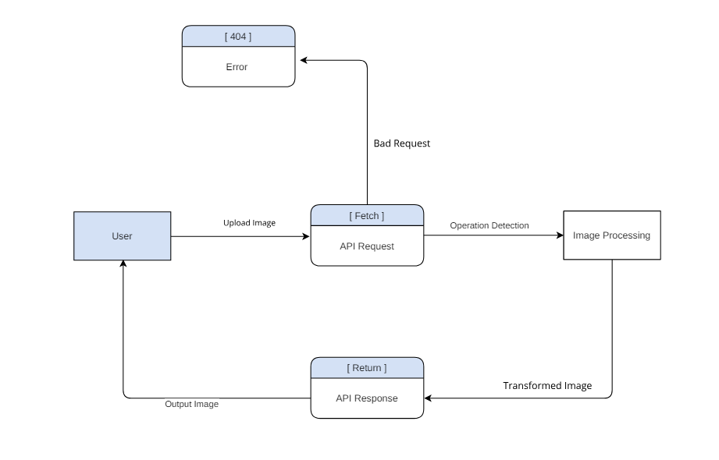
Project Workflow
Mars
Venus
Mars is actually a very cold place
Venus has extremely high temperatures
Jupiter
Saturn
planet of them all

Slide 7
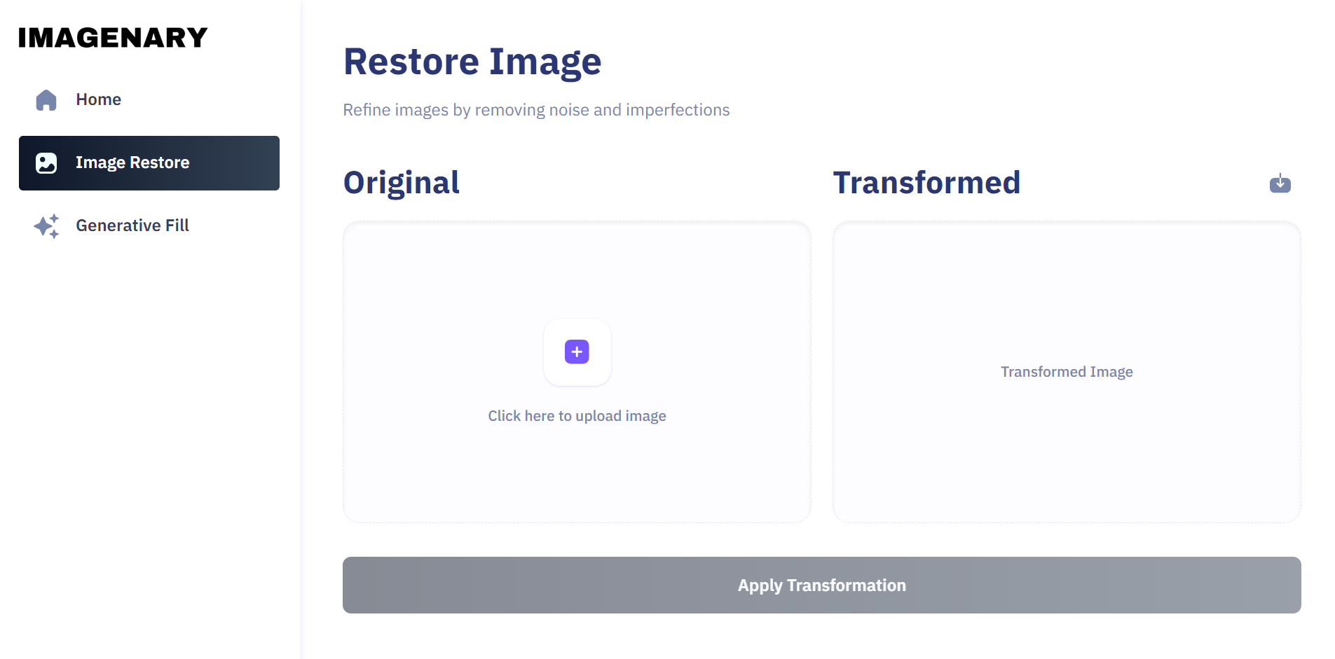
Cloudinary Upload Button
Venus
Venus has extremely high temperatures

Slide 8
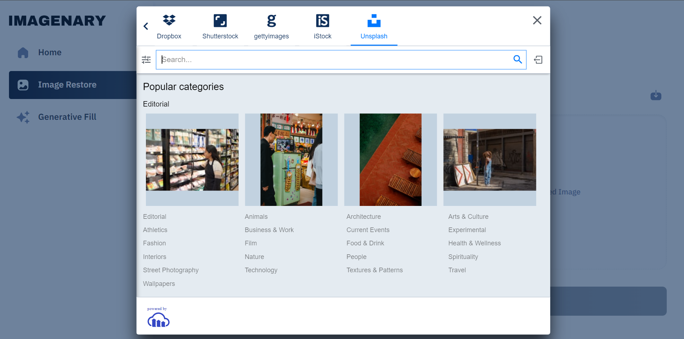
Upload Panel with Image Search
Venus
Venus has extremely high temperatures

Slide 9
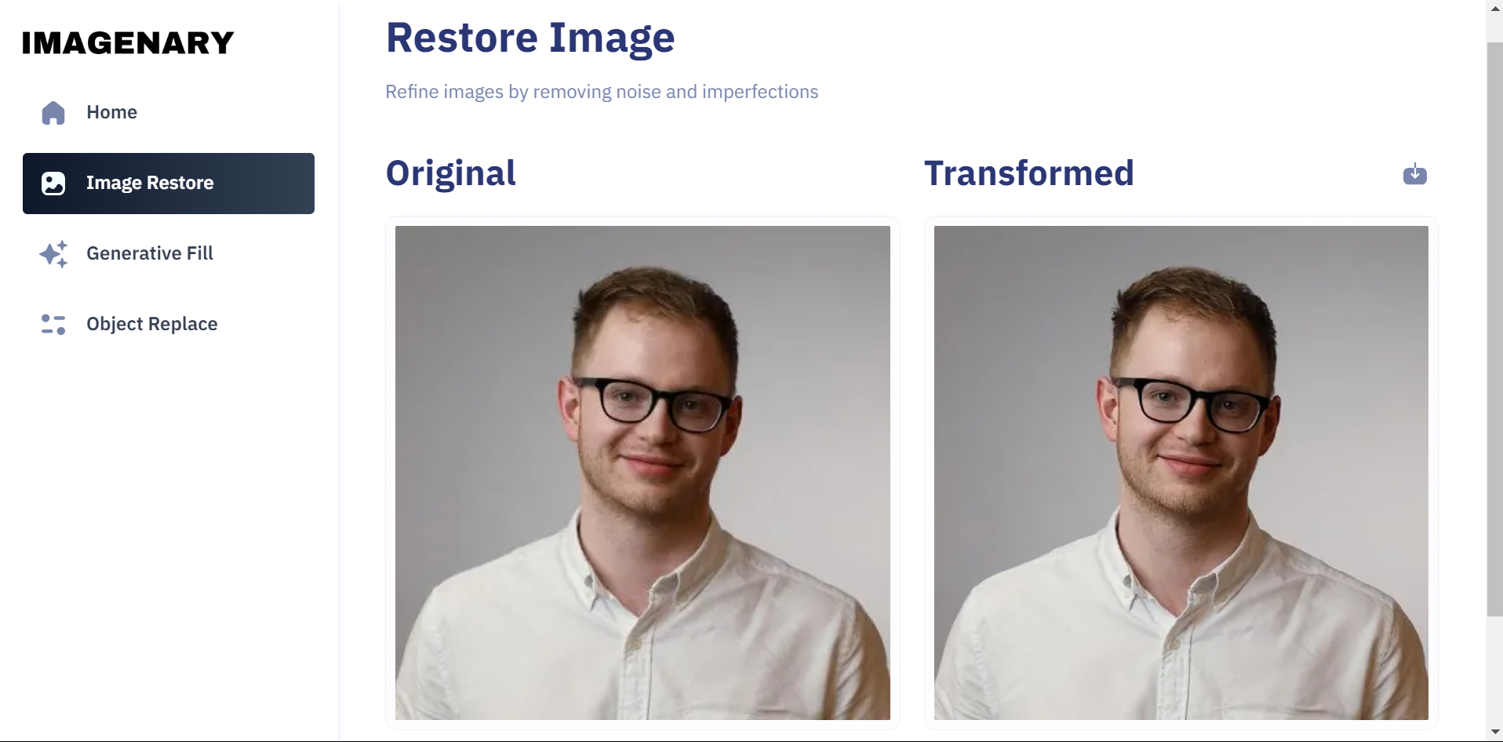
Image Restore

Slide 10
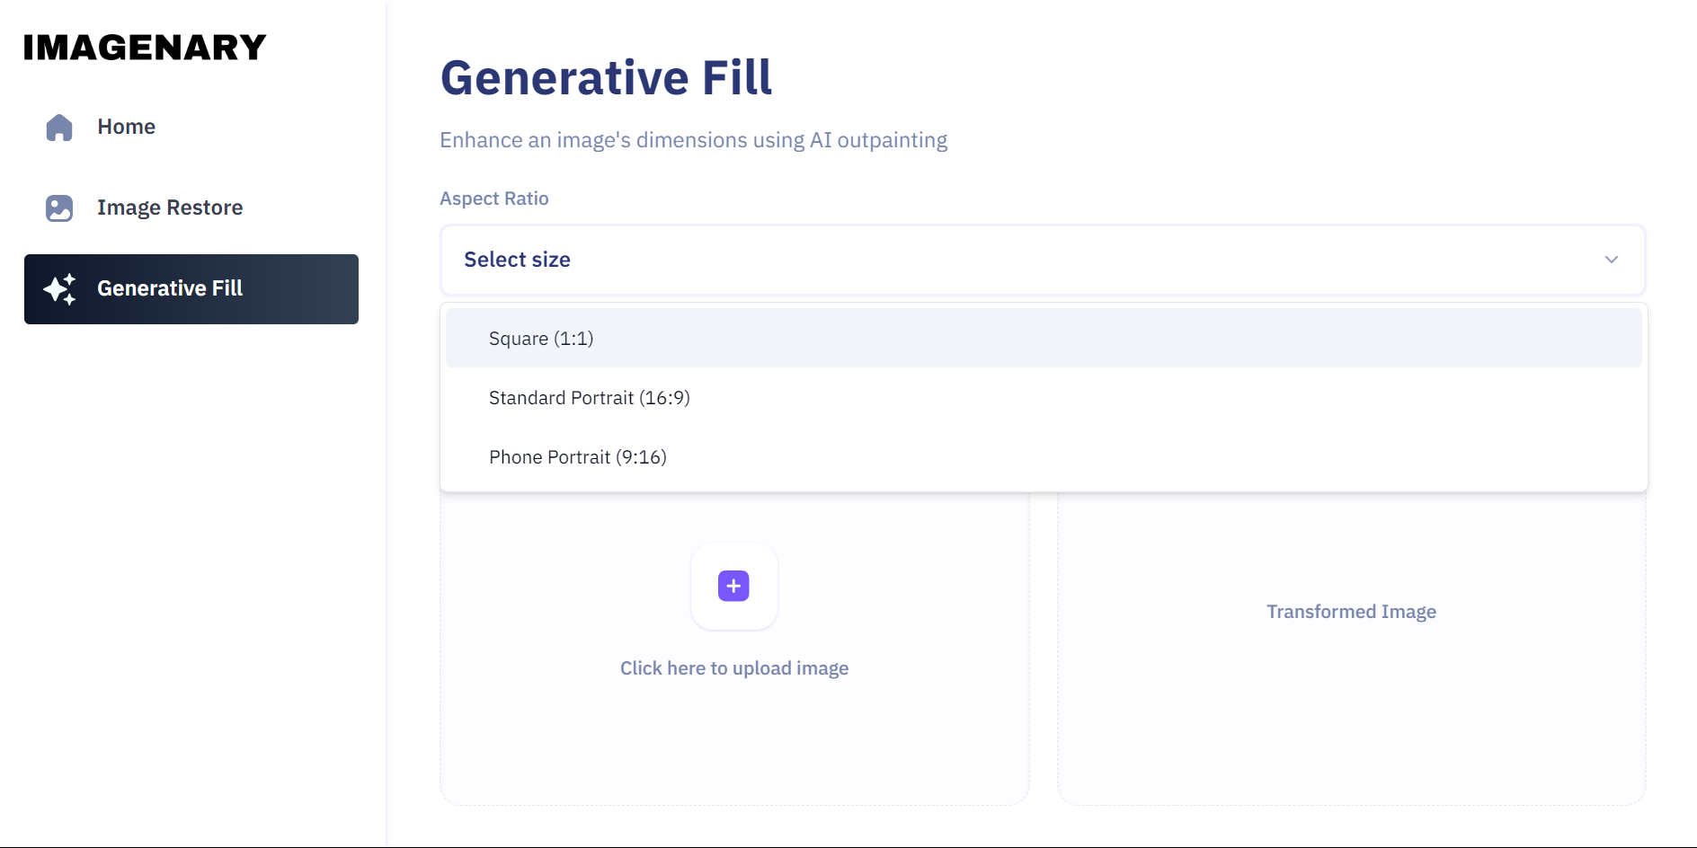
Generative Fill : Aspect Ratios

Slide 11
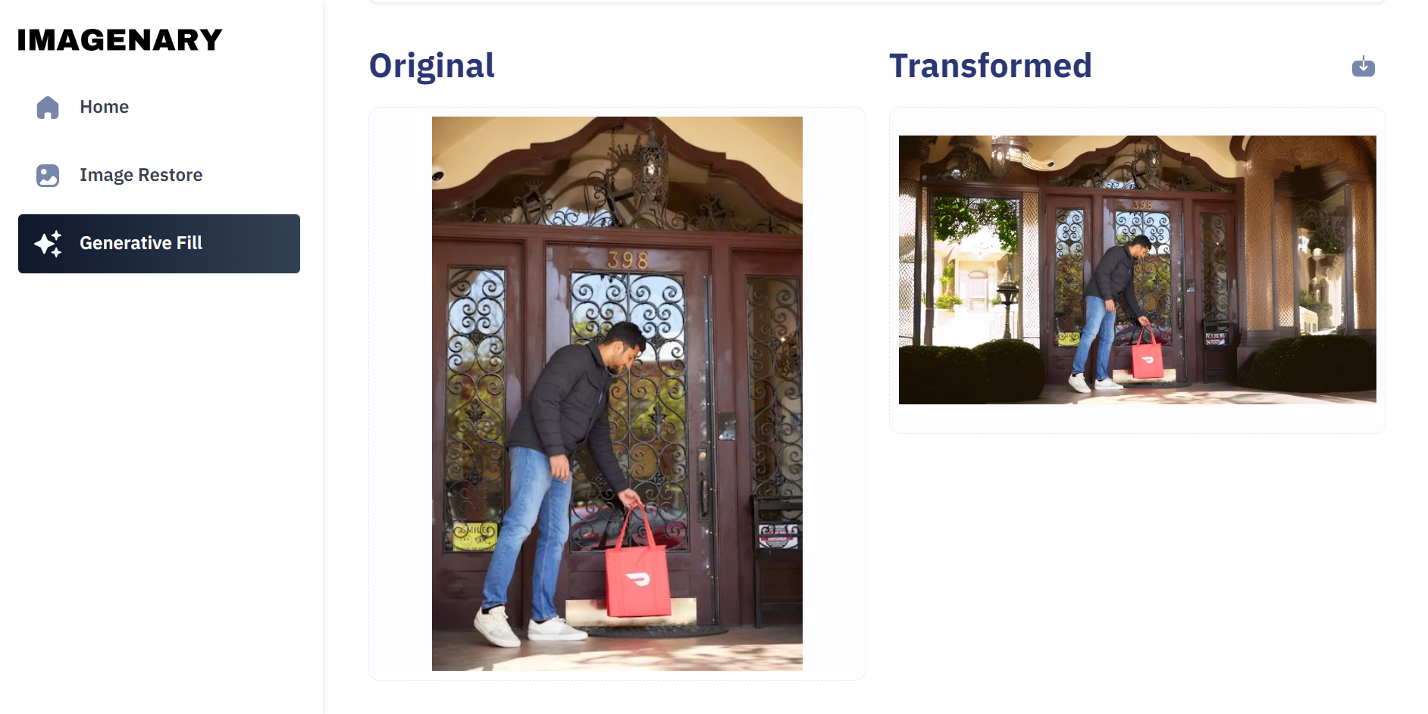
Generative Fill
25%
50%
75%
Mercury
Venus
Mars
Mercury is the closest planet to the Sun and the smallest of them all
Venus has a beautiful name and is the second planet from the Sun
Despite being red, Mars is actually a cold place. It’s full of iron oxide dust

Slide 12
Future Enhancements
New Features
User Account
Simul Task
Introduce features like Image recolor and Object Recognition
Allow users to create accounts for personalized experiences and save their work.
process multiple images simultaneously to save time.

Slide 13
Conclusion
Imagenary is an image enhancement platform with AI-driven features . It’s a free alternative to paid services like DALL-E and MidJourney
Thank You!

